Slide 1
EOMP #2
Mentor: Vu The Nam
Team: Base Steps Solution
Project: Van Lang Admission

Slide 2
Objective
Give what we have achieved in recent time
Current progress report
Given the problems that occurred in team and the lessons learned

Slide 3
Outline
Introduction project
Requirement
Architecture
Progress of project
Risk and issue report
Reflection

Slide 4
Introduction project

Slide 5
Base Steps Solution
Mentor: Vu The Nam
Members:
Nguyen Thai Hien
Tran Xuan Hai
Nguyen Hoang Anh Tai
Nguyen Anh Khoi
Doan Anh Minh
Nguyen Xuan Thai Hien

Slide 6
Project overview
Project name: Van Lang admission
Customer: Van Lang university
Goals:
Create a website Van Lang Admission for customer with high quality & the most reasonable price
Website can work with the best performance and take this site close to all student in Viet Nam
Website can help introduce all information and make a good look for Van Lang university
Website can help students lookup their admission information correctly & clearly

Slide 7
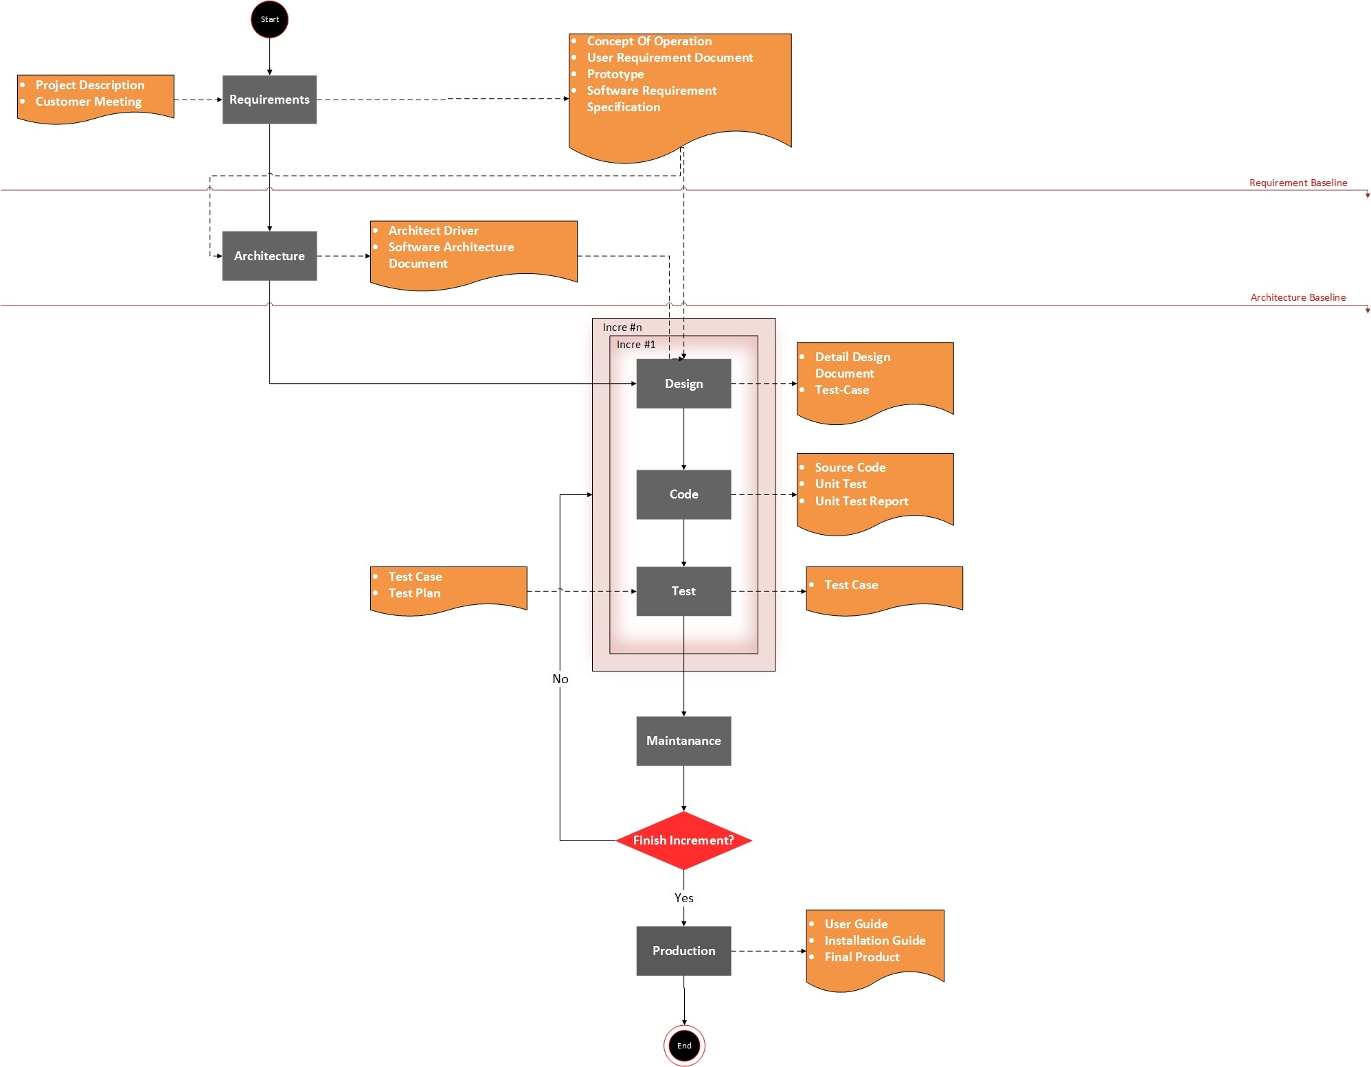
Software development process

Slide 8
Requirement

Slide 9
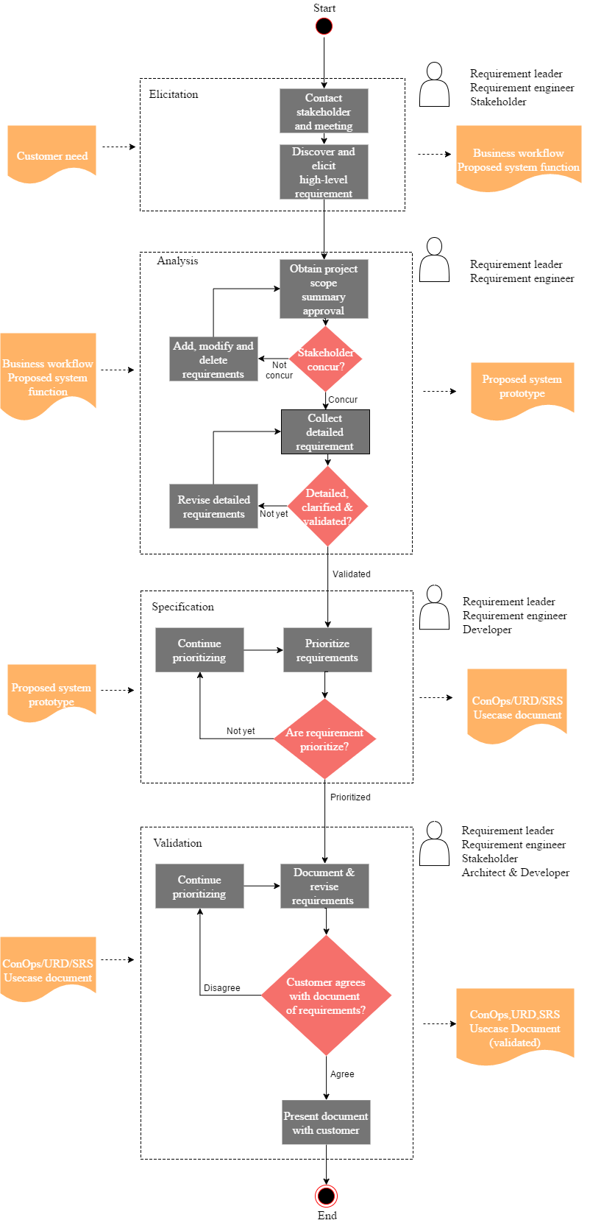
Requirement process

Slide 10
Quality attribute
Id | Quality Attribute | Description | Priority
SQA-P01 | Performance | When users use the system to view the necessary information, the system will respond quickly, display results in 2 seconds | High
SQA-P02 |  | Education staffs can import point into system average 1000 points will import about 4 seconds | High
SQA-A01 | Availability | When Web server unresponsive, can re-operation quickly | High
SQA-C01 | Scalability | System can expand limit number of users | High
SQA-U01 | Usability | System has friendly interface and easy to use | Medium
SQA-R01 | Portability | Users can use the system on mobile platform | Medium
SQA-M01 | Modifiability | The system can add/delete/modify other functions later | Medium
SQA-S01 | Security | System can authorize user’s information | Low

Slide 11
Architecture

Slide 12
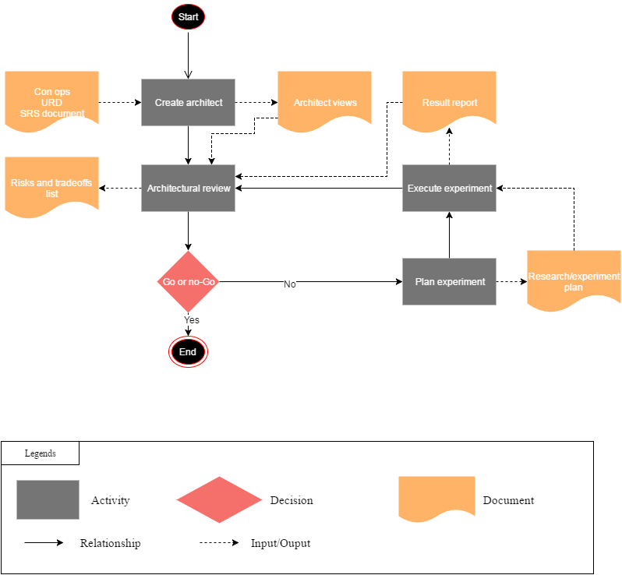
Architect process

Slide 13
Physical view

Slide 14
Dynamic view

Slide 15
Static view

Slide 16
Progress of project

Slide 17
Schedule

Slide 20
Risk and issue report

Slide 21
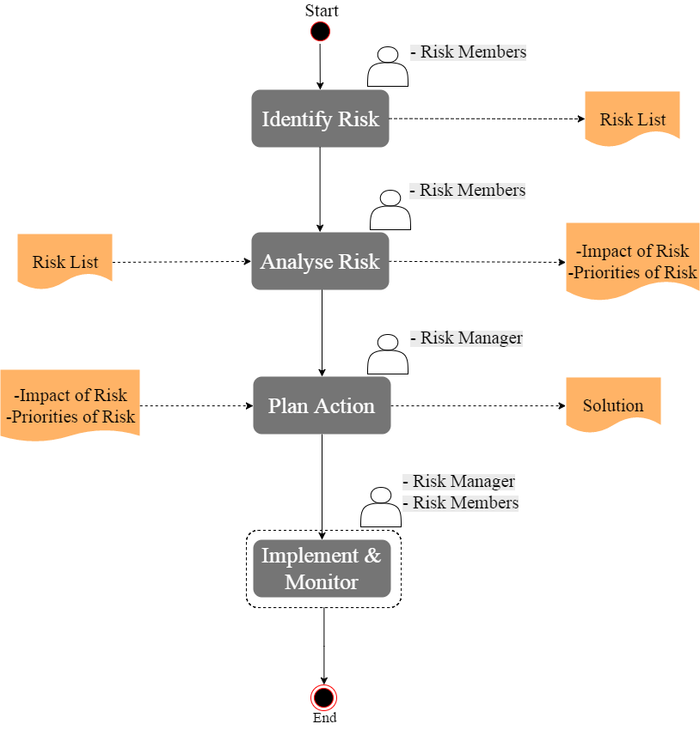
Risk management process

Slide 23
Reflection

Slide 25
Thank for your attention!

